Slide 1
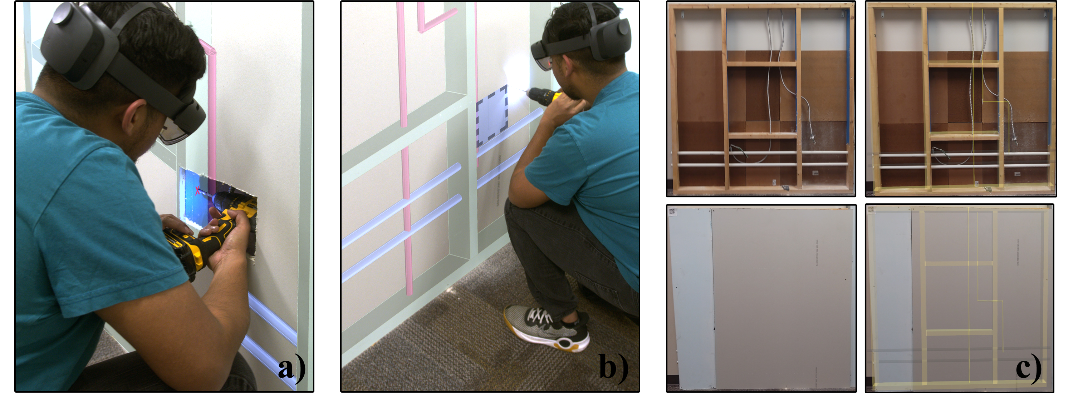
Investigating the Impact of Augmented Reality and BIM on Retrofitting Training for Non-experts
ISMAR2023
Submission ID: 1015

Slide 2
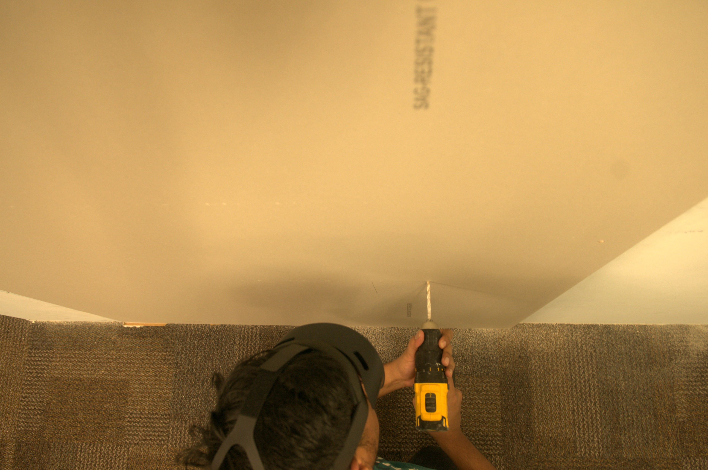

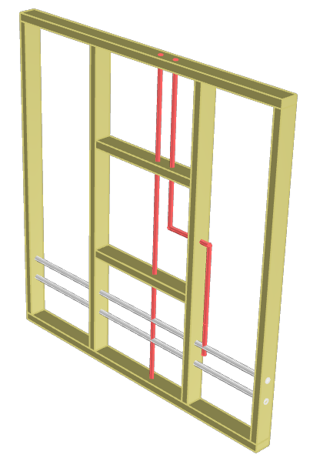
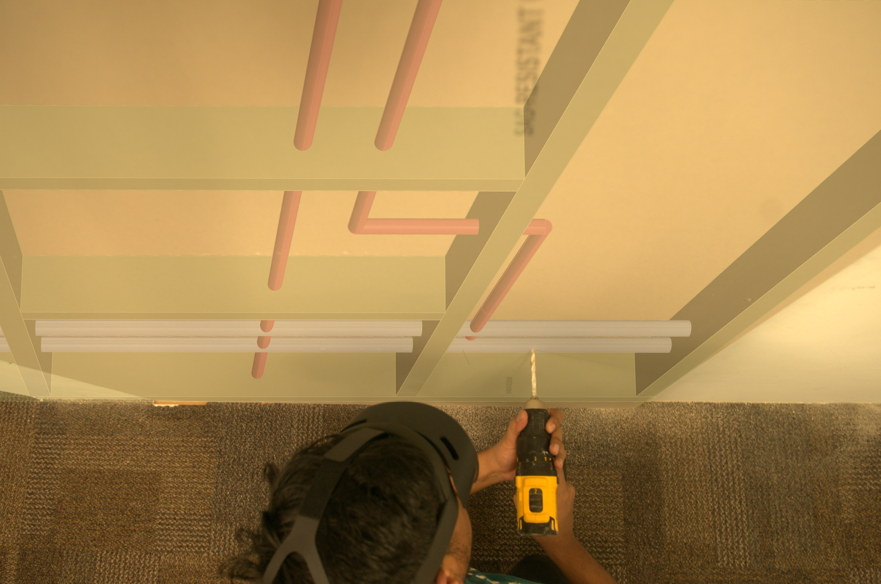

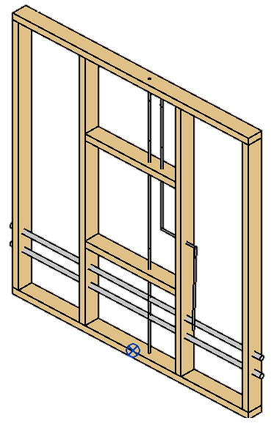
Retrofitting
Building Information Modeling
Augmented Reality
Augmenting and displaying BIM data during retrofitting training

Slide 3
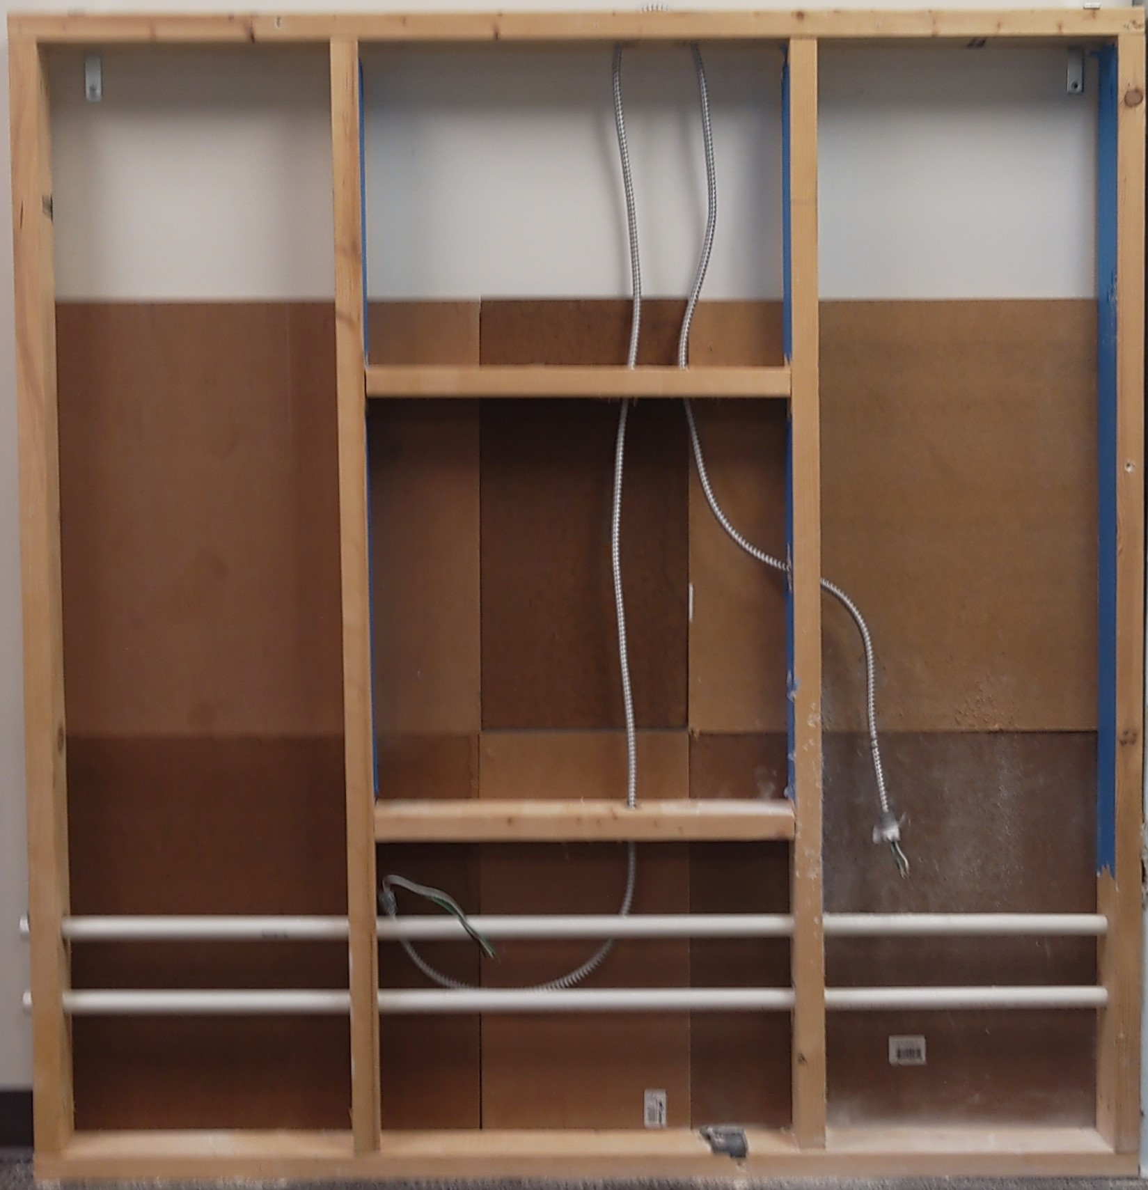
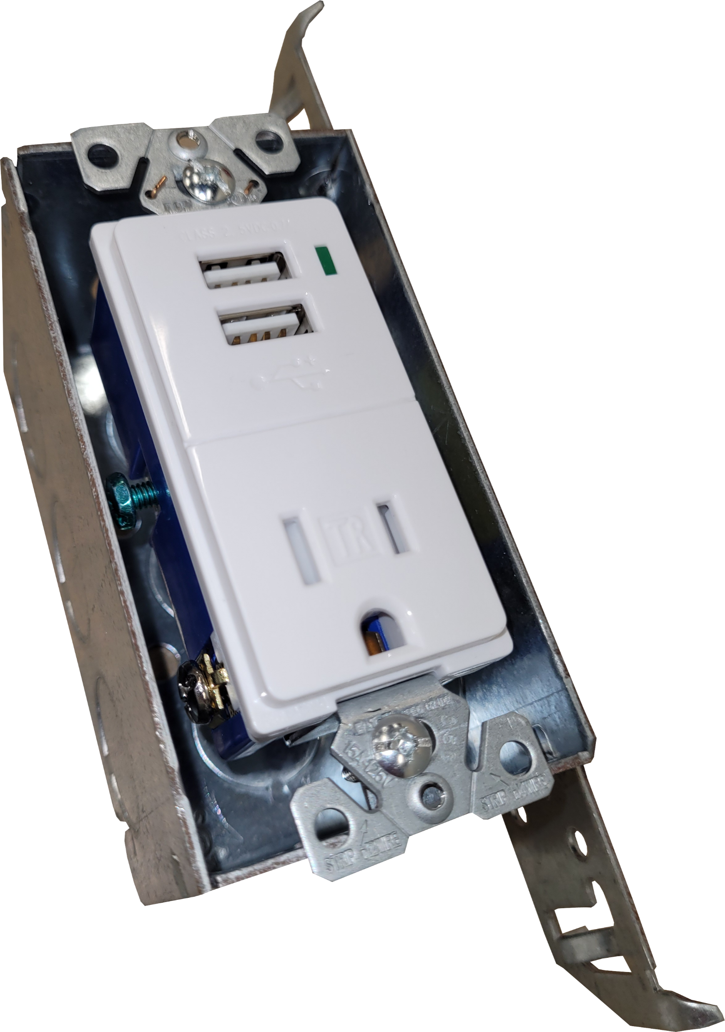
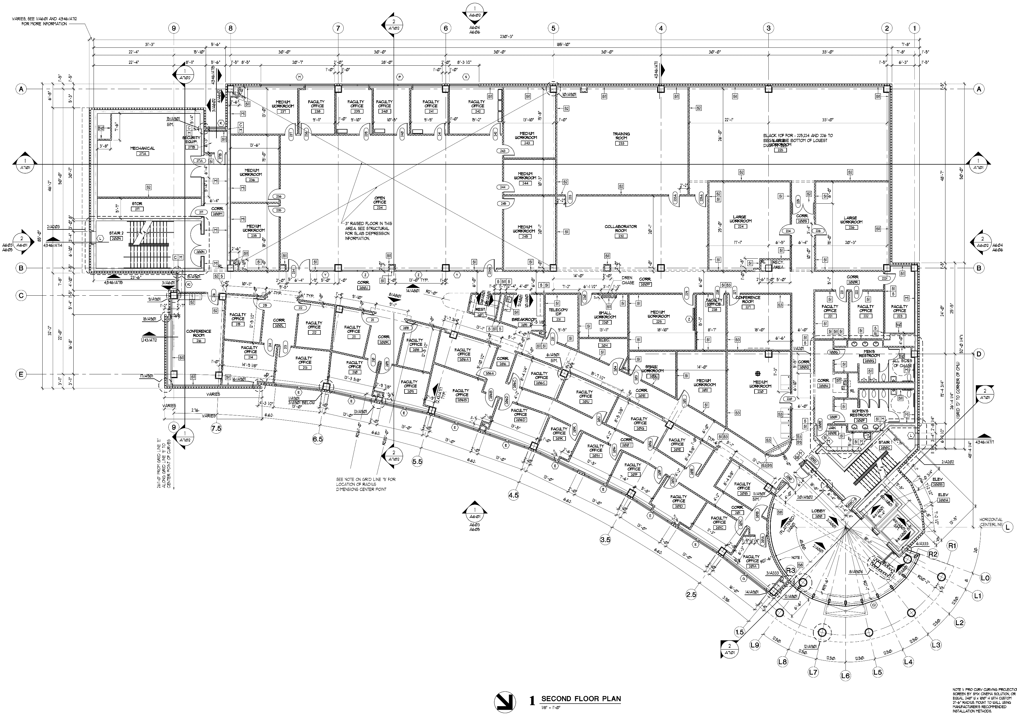
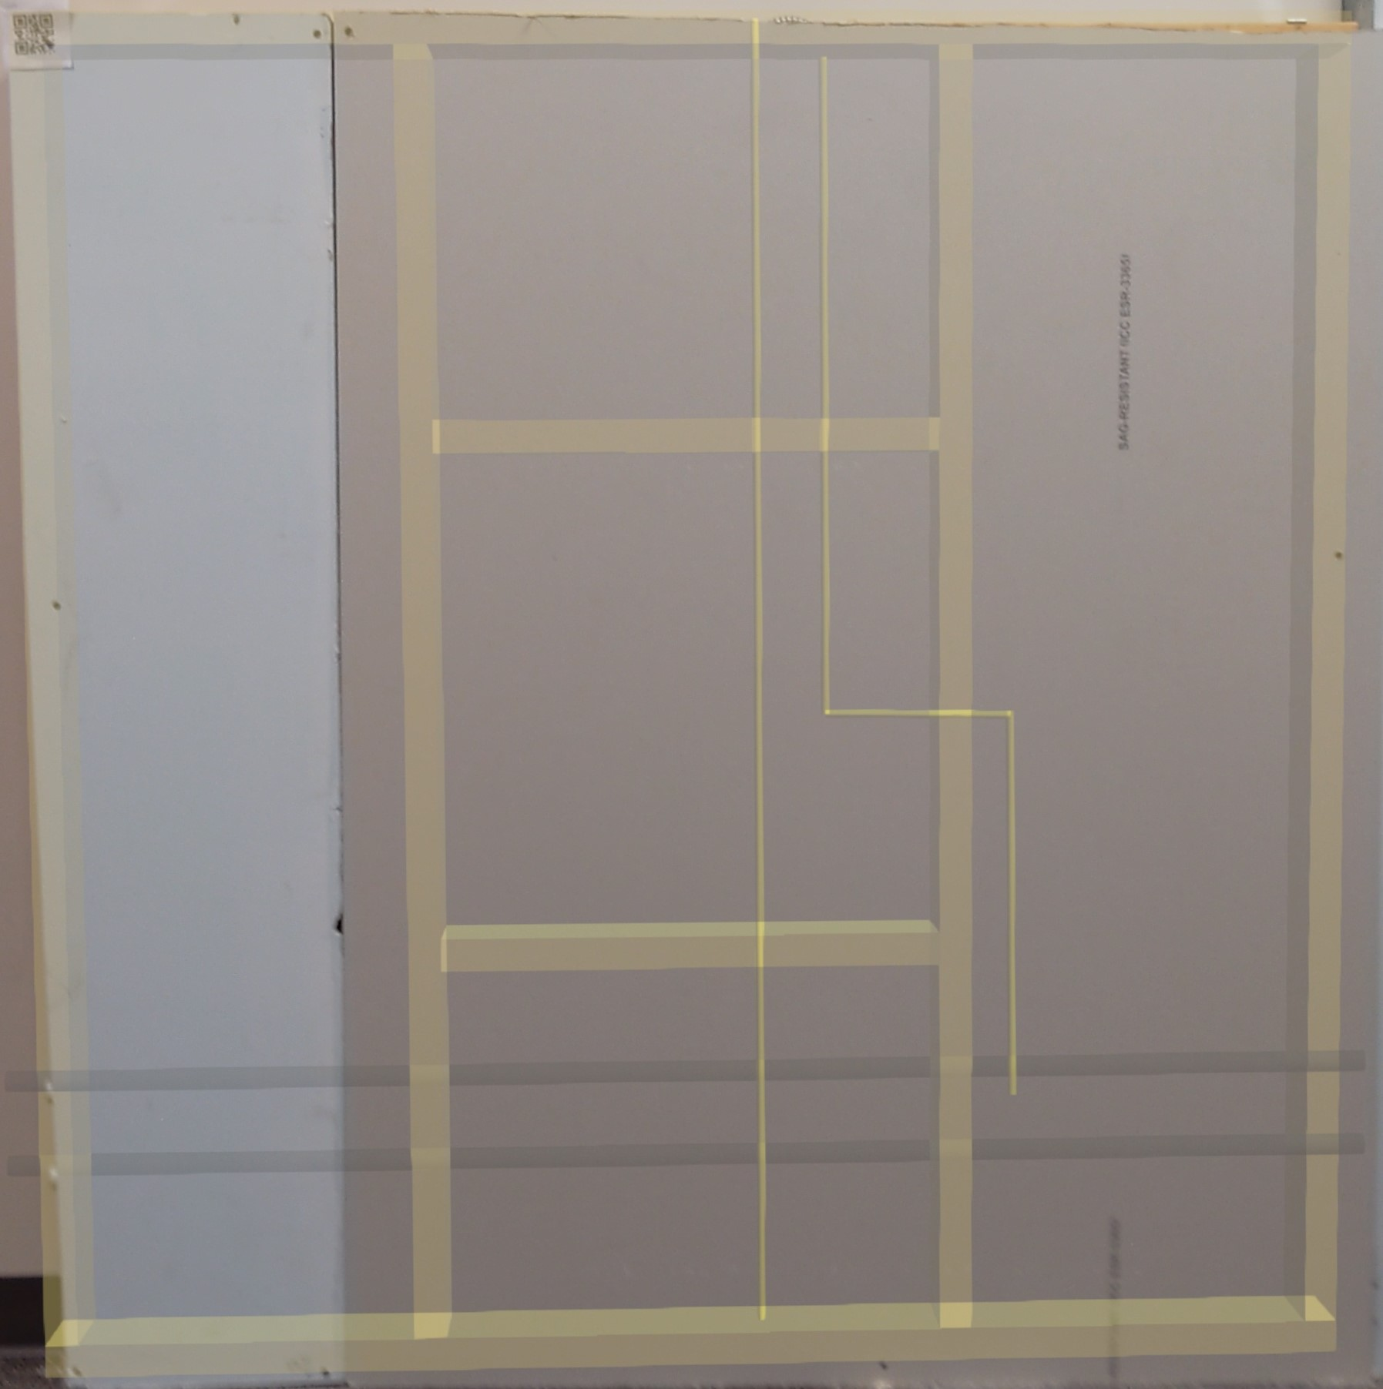
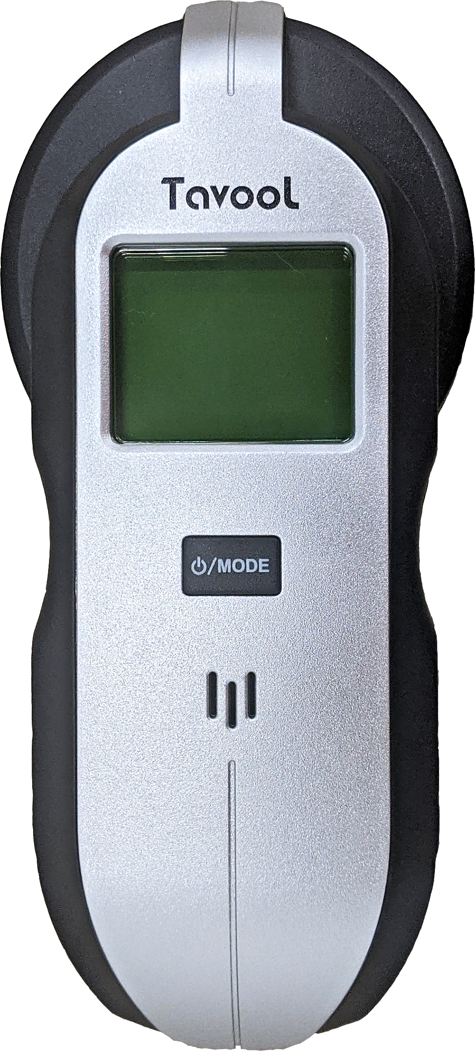
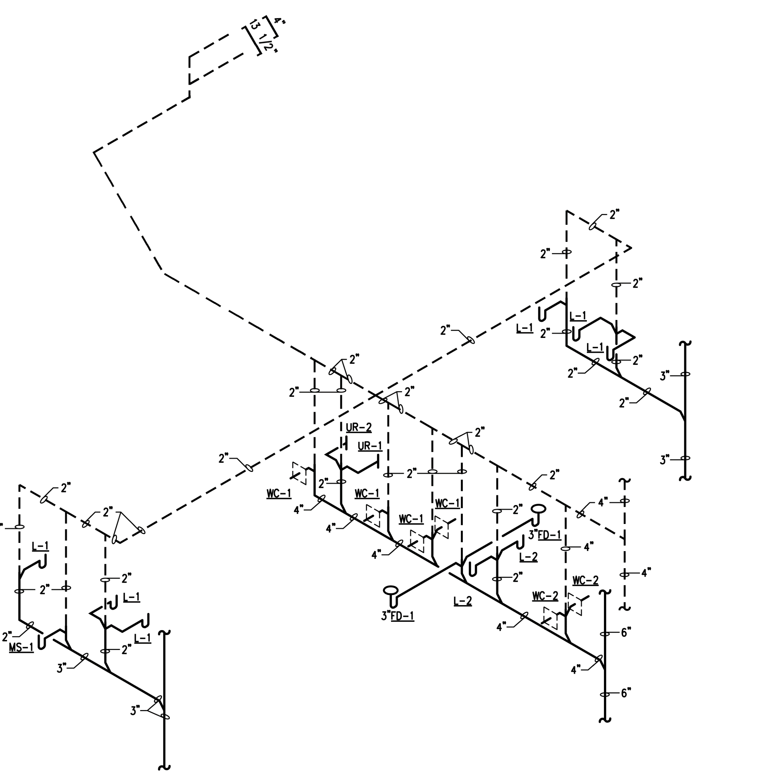
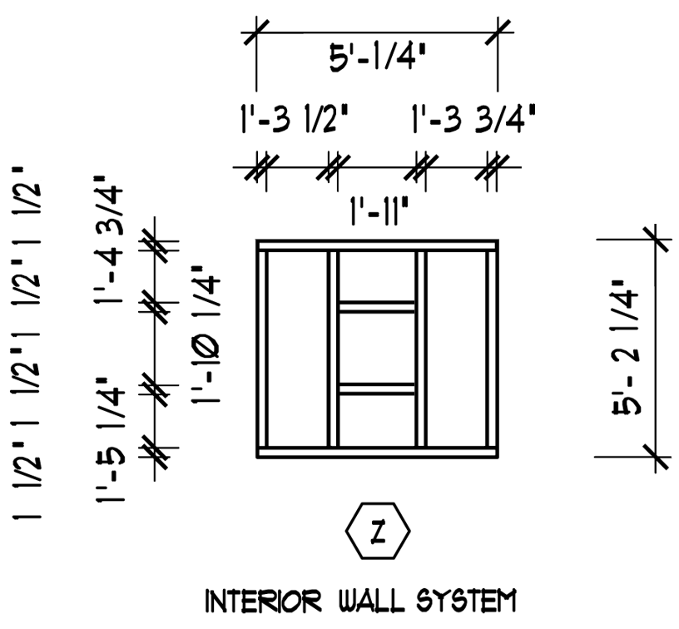
Study Design
“What are they doing?”
“How are they divided?”
Conventional Documentation
BIM-enabled AR
Electrical outlet installation
(n = 32)
(n = 32)

Slide 4
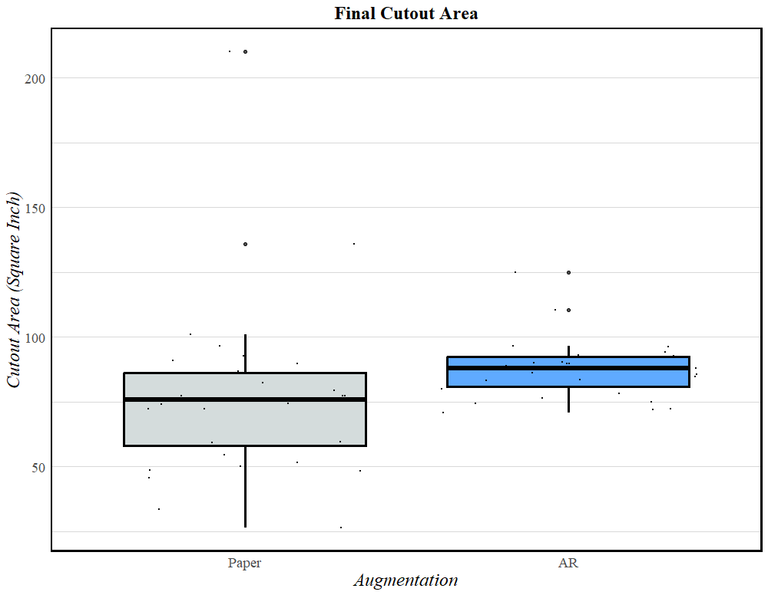
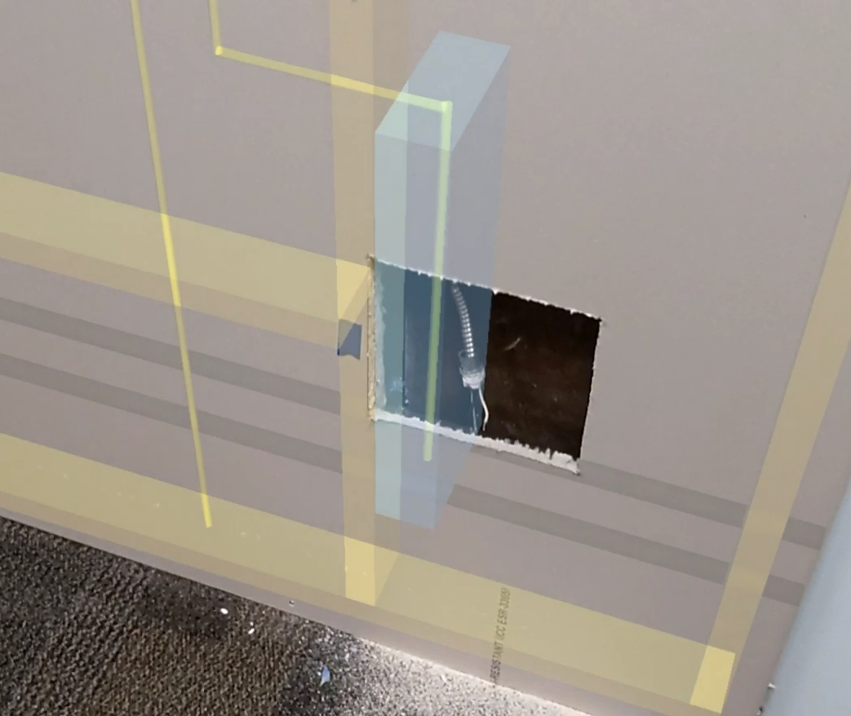
Cutout Area
 | Median*¹ | SD*²
AR | 88.04 | 10.90
Paper | 75.73 | 32.40
*1 – Significant difference confirmed by Wilcoxin Rank Sum Test
*2 – Unequal variance confirmed by Levene’s test

Slide 5
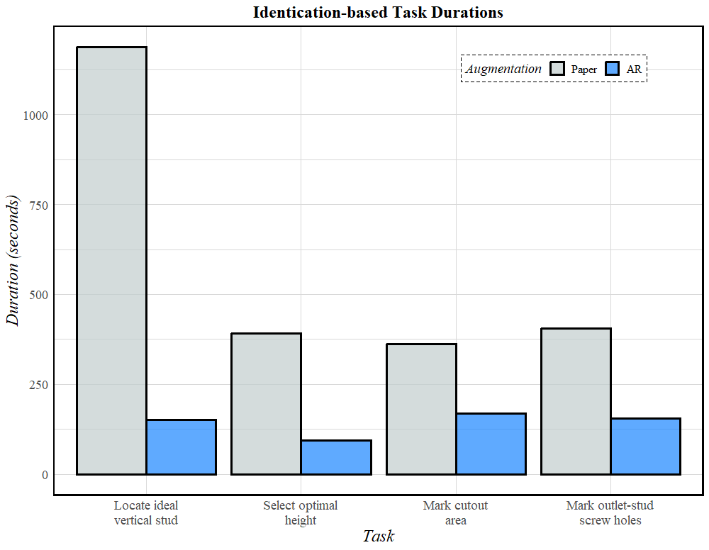
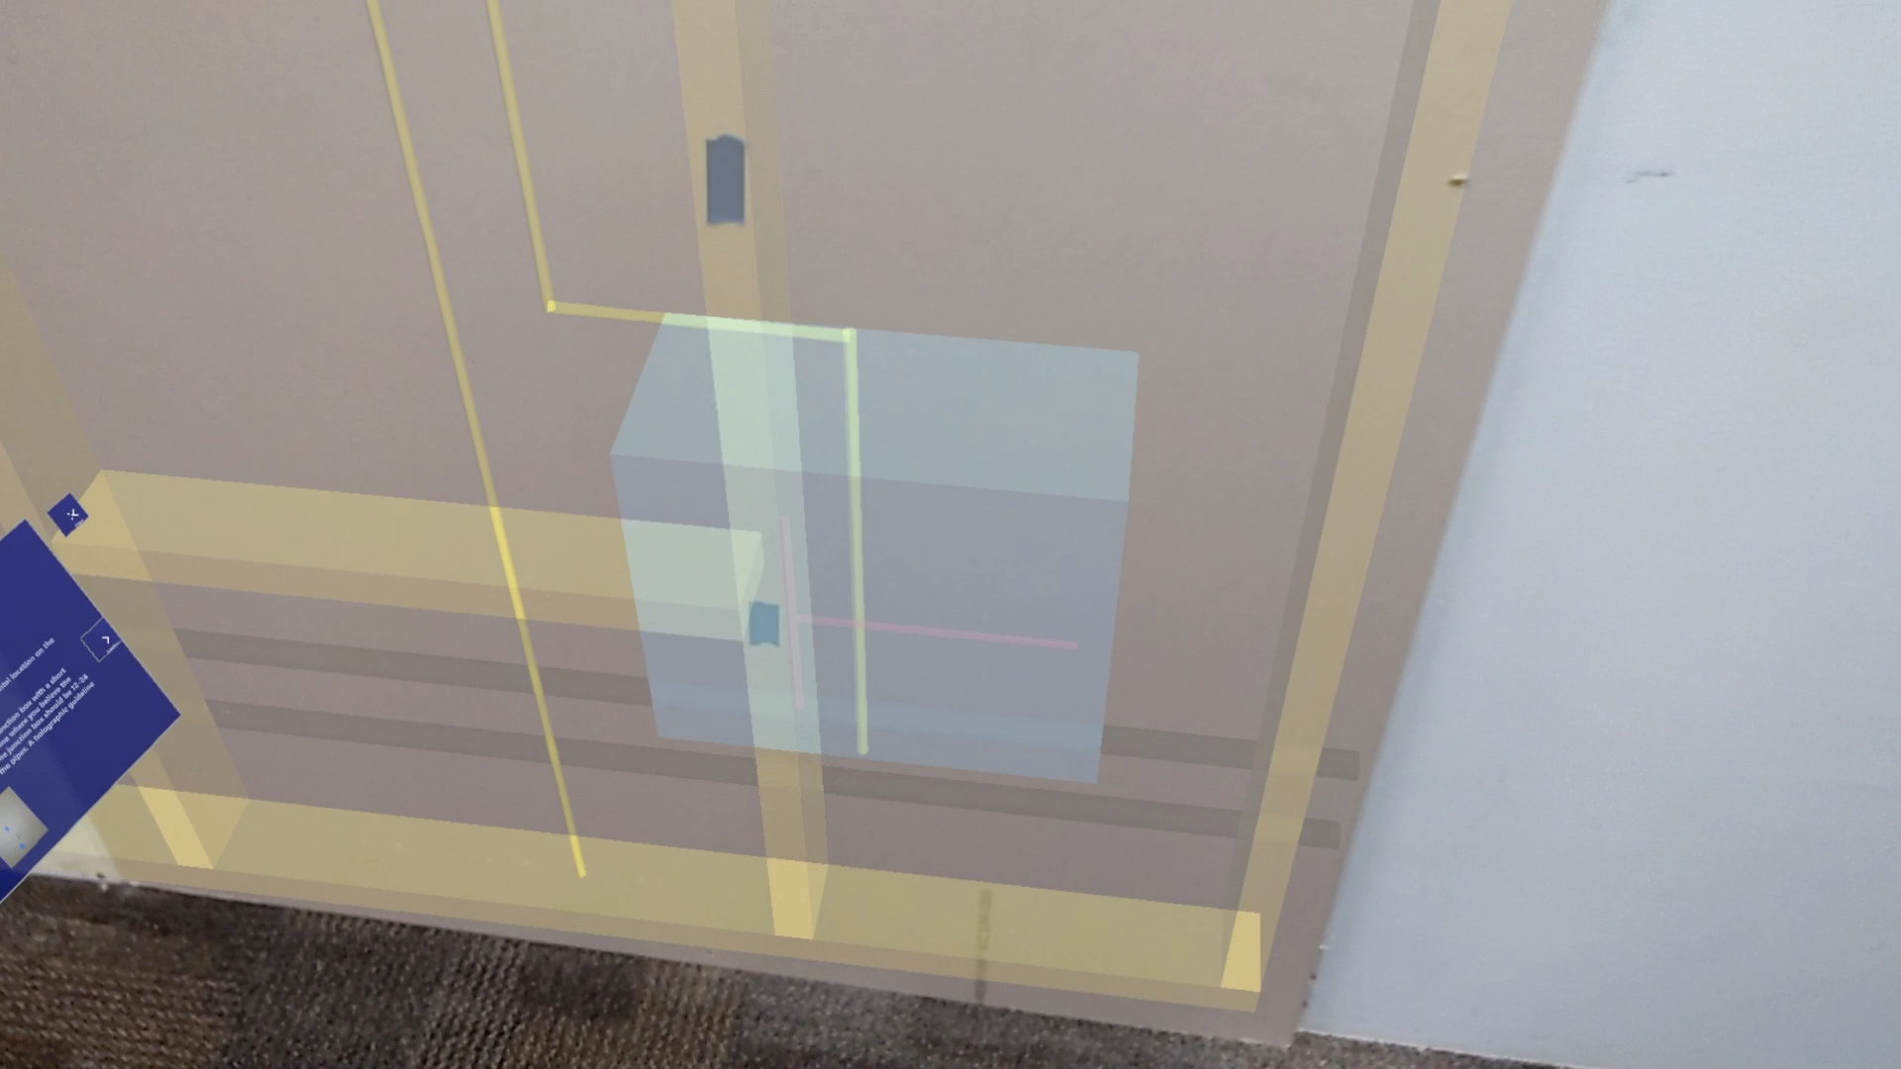
Task | Group | Median*¹ | SD
1 | AR | 129.23 | 81.02
1 | Paper | 1142.34 | 655.27
2 | AR | 82.22 | 45.84
2 | Paper | 293.02 | 267.64
3 | AR | 163.38 | 62.51
3 | Paper | 375.68 | 140.31
4 | AR | 130.12 | 97.91
4 | Paper | 360.58 | 262.36
1
2
3
4
*1 – Significant differences confirmed by Wilcoxin Rank Sum Test

Slide 6
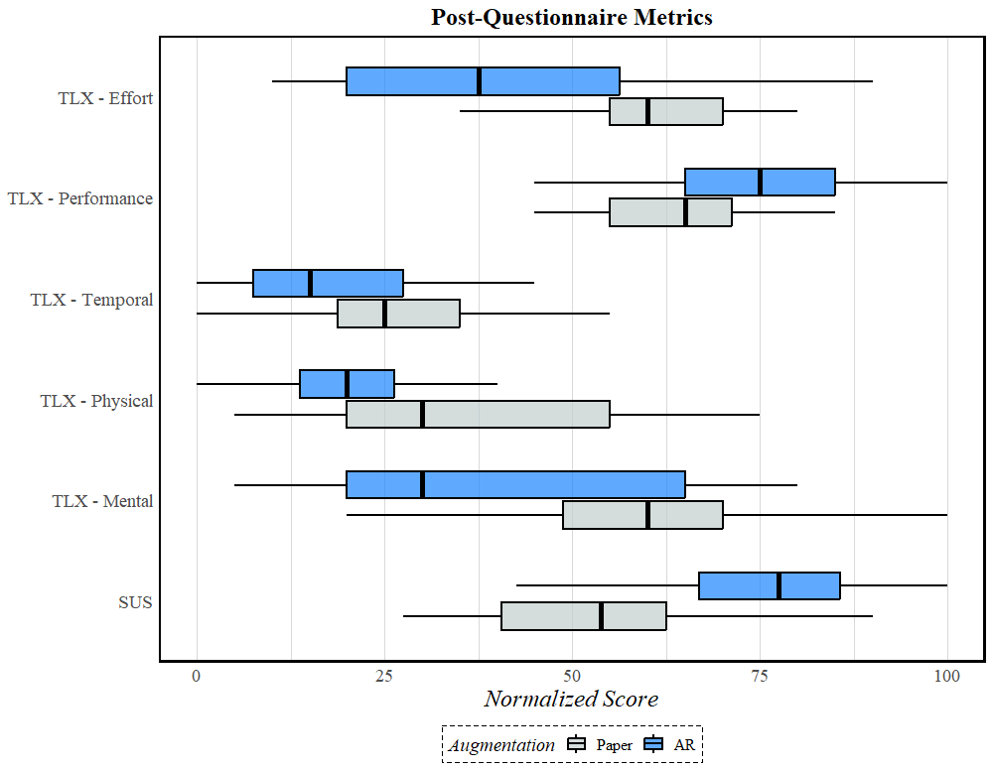
NASA Task Load Index (TLX)
System Usability Scale (SUS)
Significant differences confirmed by Wilcoxin Rank Sum Test in:
System Usability Mental Demand Physical Demand Effort Demand Self-reported Performance

Slide 7
Thank you

Slide 8
LEGACY SLIDES

Slide 9
Premise
Augmenting and displaying BIM data during retrofitting training
Retrofitting
Building Information Modeling
Augmented Reality

Slide 10
Premise
Augmenting and displaying BIM data during retrofitting training
Retrofitting
Building Information Modeling
Augmented Reality

Slide 11
AR-BIM Demonstration

Slide 12
Paper Demonstration

